Slide 1
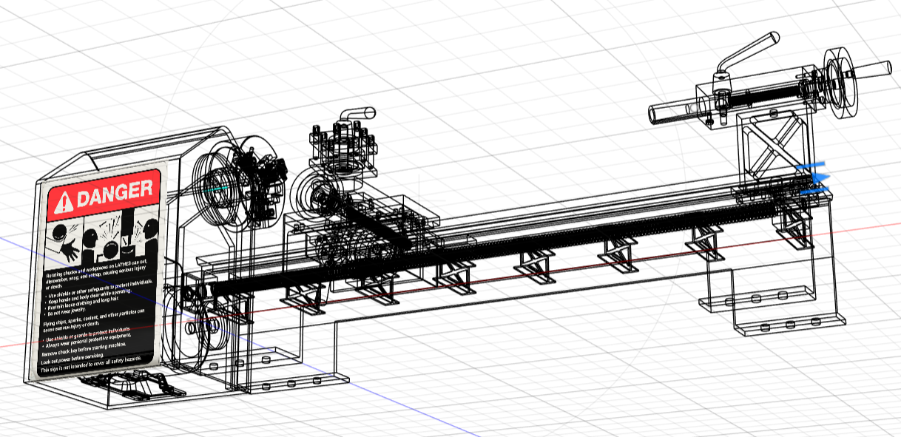
Lathe Machine
GROUP 5
PUSHKIN (B22ME052) MUKESH (B22ME041)
VIPUL (B22ME069) GOPAL (B22ME075)
LAVISH (B22ME035) GAURAV (B22ME020)

Slide 2
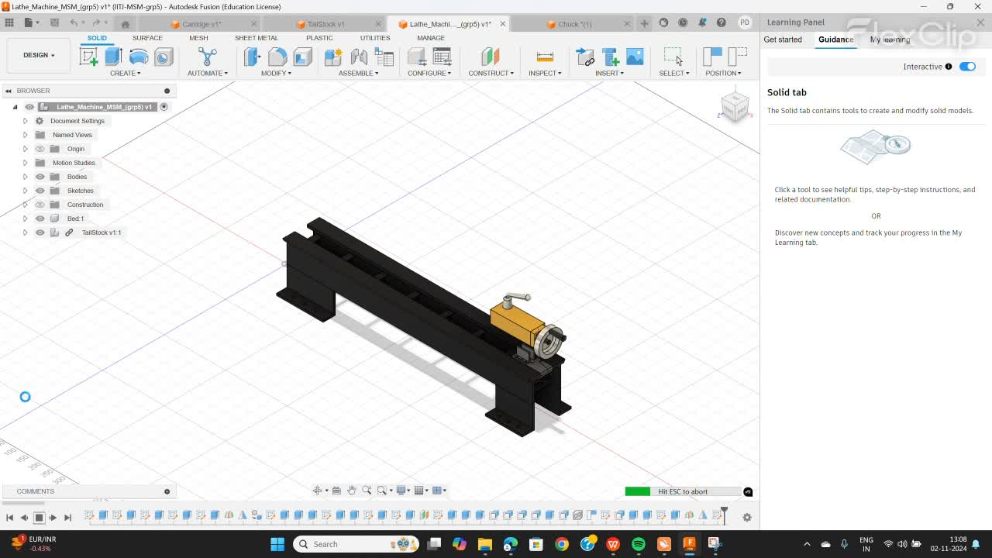
Purpose and Objective of the Model
Reverse Engineering: Modeled the lathe machine by analyzing each part’s functionality.
Tool Design & Assembly Simulation: Gained insights into the lathe tool design and assembly process through detailed simulations.
Enhanced Understanding: Improved comprehension of component interactions and assembly procedures.

Slide 3
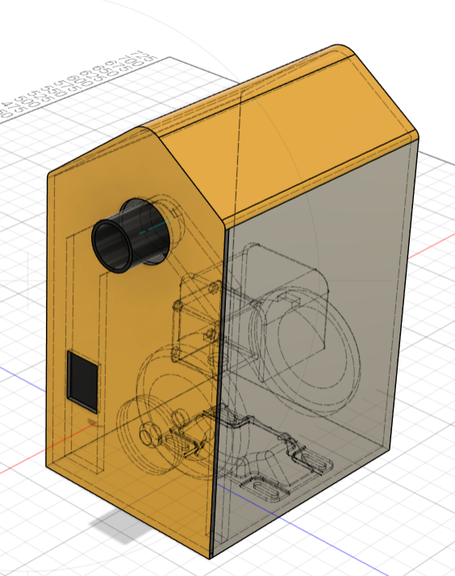
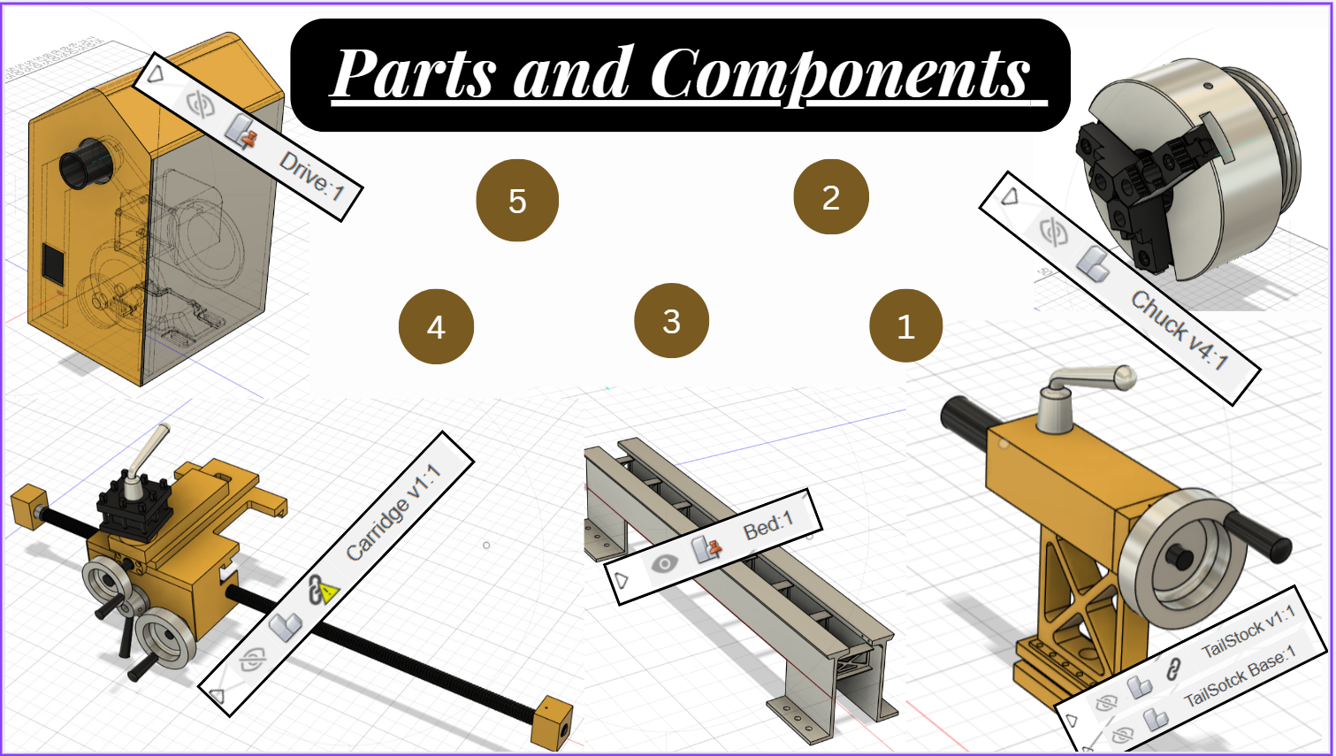
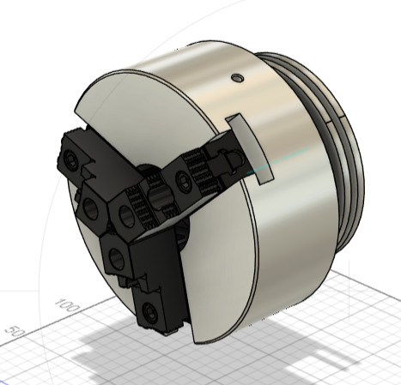

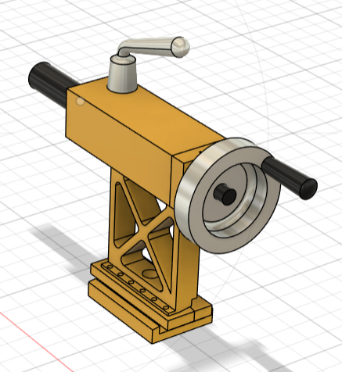
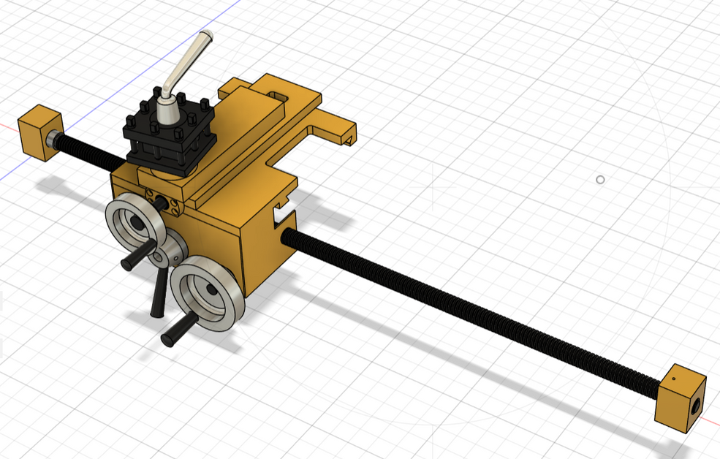
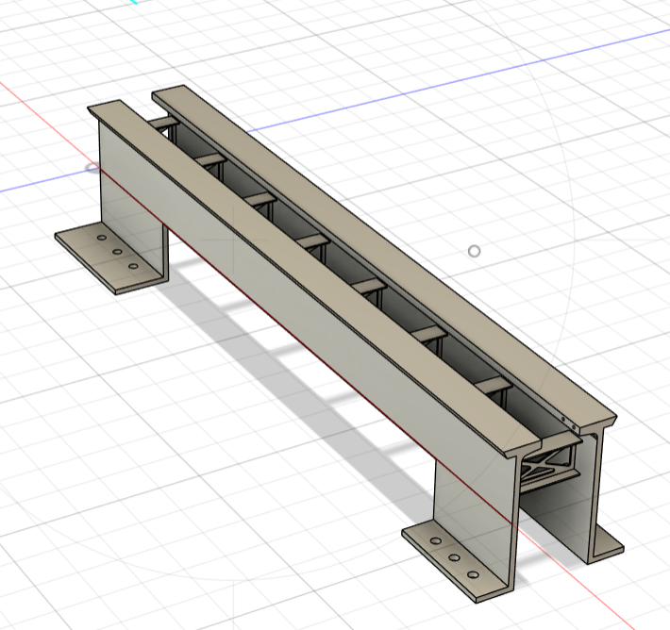


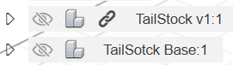
5
2
4
3
1

Slide 4
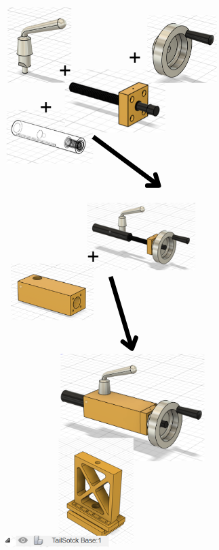
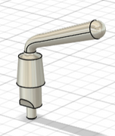
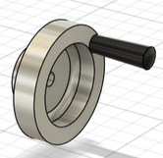
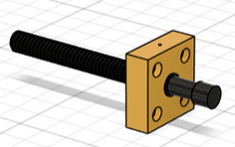
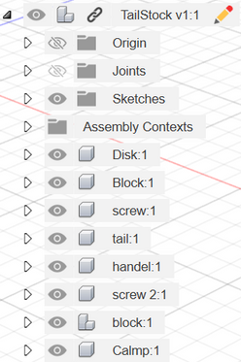
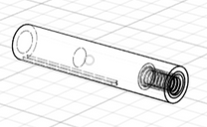
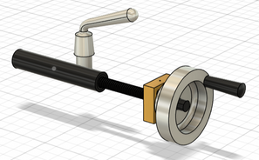
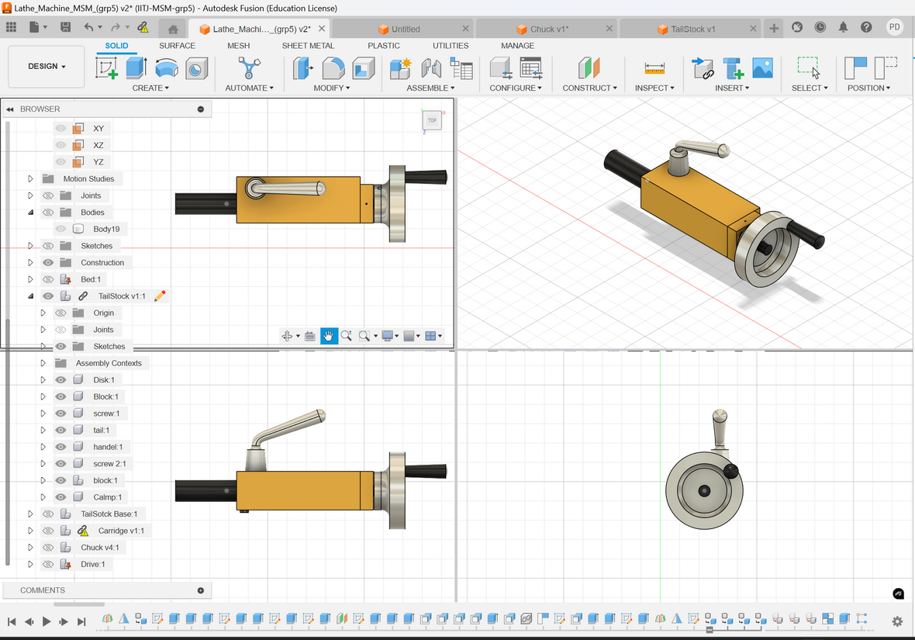
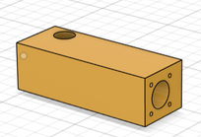
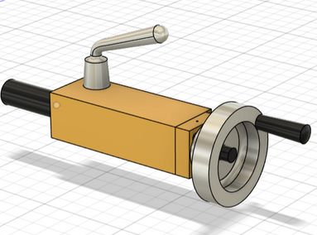
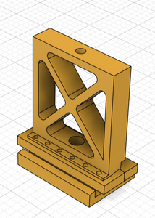
Tailstock
Handle
Function: The handle is used to manually move the quill or the entire tailstock along the lathe bed. It controls the forward and backward motion of the tailstock for positioning.
Movement: Rotates to extend or retract the spindle.
Quill (Screw Assembly)
Function: The quill holds tools like drills or centers and provides precise movement for machining operations.
Movement: Moves axially (in and out) to push tools into or away from the workpiece.
+
+
+
Disk (Spindle Mount)
Function: The disk interfaces with the quill and provides support for accurate rotation and positioning of tools.
Movement: Rotates with the spindle when needed or remains stationary.
+
Block (Tailstock Housing)
Function: The block provides structural support, holding the entire tailstock assembly together. It keeps the parts aligned and facilitates easy mounting on the lathe bed.
Movement: Moves along the lathe bed for positioning relative to the workpiece.
Clamp/Base
Function: The clamp secures the tailstock in place on the lathe bed to prevent unwanted movement during operation.
Movement: Locks and unlocks to slide along or stay fixed on the lathe bed.

Slide 5
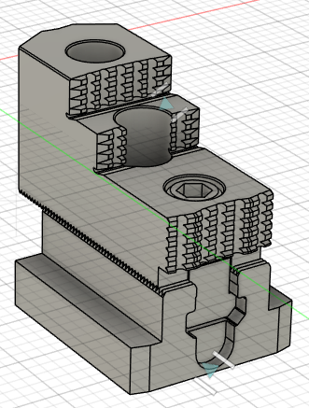
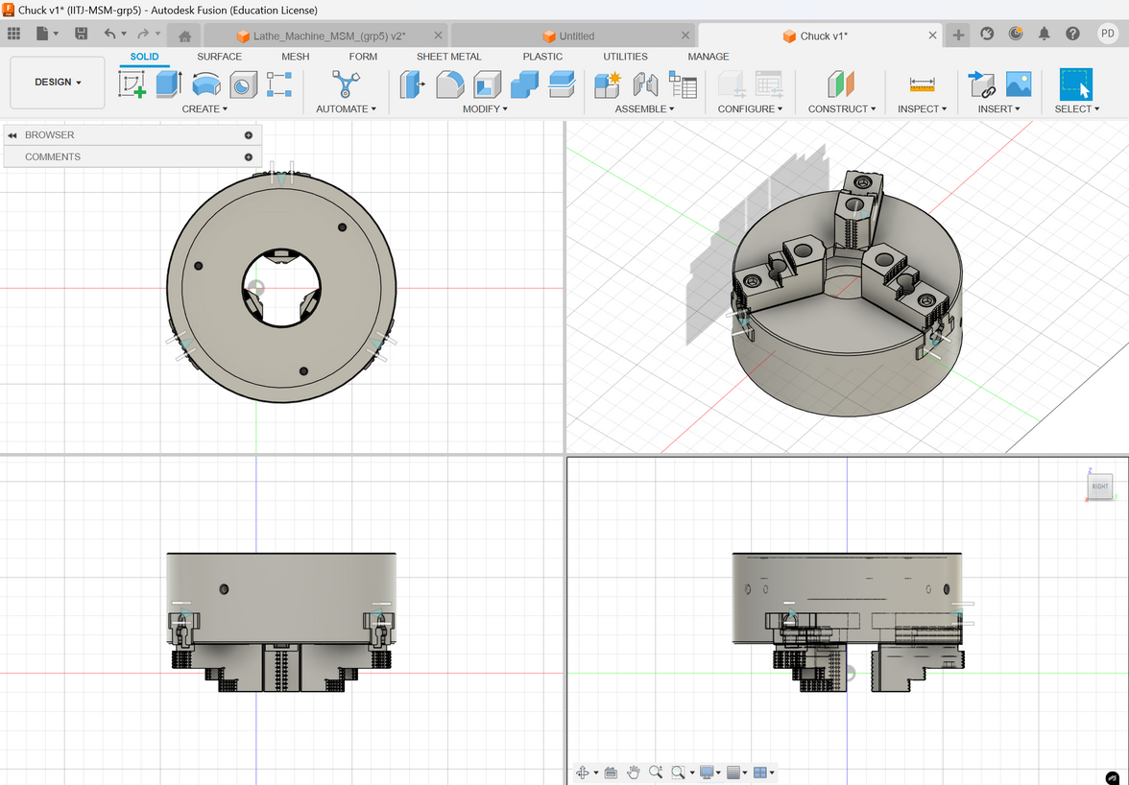
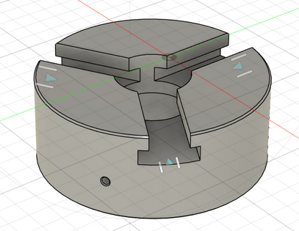
Chuck
Versatile Holding
Self-Centering
Quick Setup
Secure Grip
Joint Sliders (Jaws) - Function:
The jaws adjust radially to accommodate different workpiece sizes, tightened or loosened using a key mechanism.
Chuck Function
A lathe chuck secures the workpiece on the spindle using jaws, ensuring stable rotation during machining. Commonly, self-centering chucks with three jaws are used to hold round or hexagonal workpieces, providing precise alignment.

Slide 6
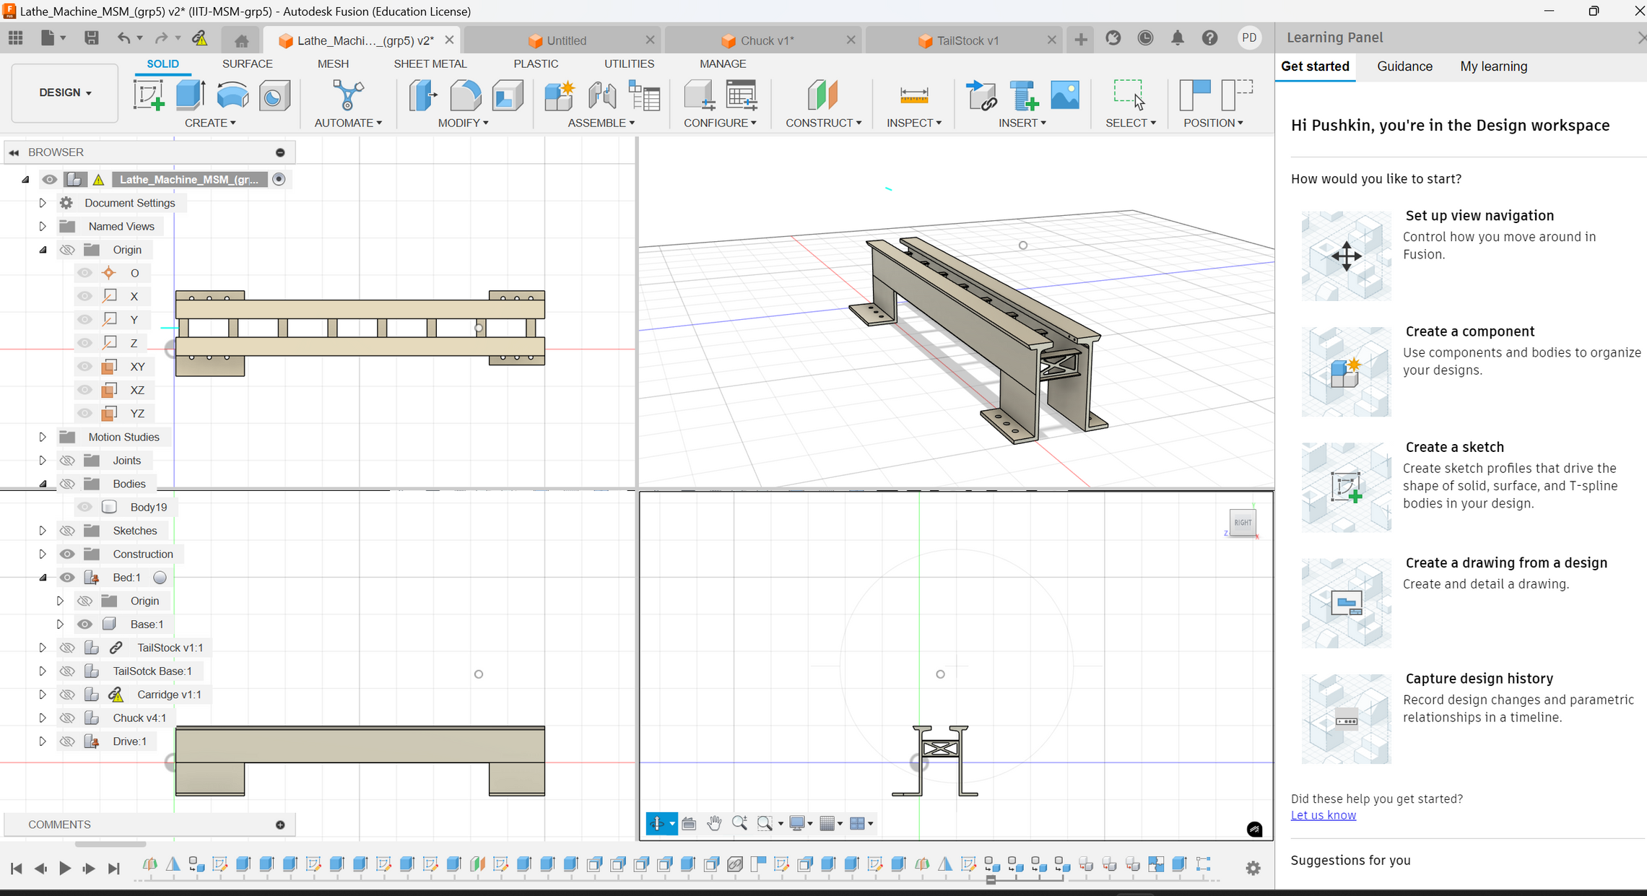
BED
Impact on Efficiency
Precision: Maintains high dimensional accuracy and reduces machining errors.
Load Capacity: Supports heavy workpieces without distortion, increasing versatility.
Reduced Downtime: Enhances reliability, minimizing maintenance and operational delays.
Advantages
Rigidity: Ensures stable, vibration-free machining.
Durability: Long-lasting, wear-resistant construction.
High Finish Quality: Facilitates superior surface finishes.
Versatility: Supports various machining operations efficiently.
Function
Structural Support: Provides a rigid foundation, aligning the headstock, tailstock, and carriage along the lathe’s longitudinal axis.
Guideways: Ensures precise, smooth sliding of the carriage and tailstock, maintaining accurate tool positioning.
Vibration Damping: Minimizes operational vibrations, enhancing machining precision and surface finish.

Slide 7

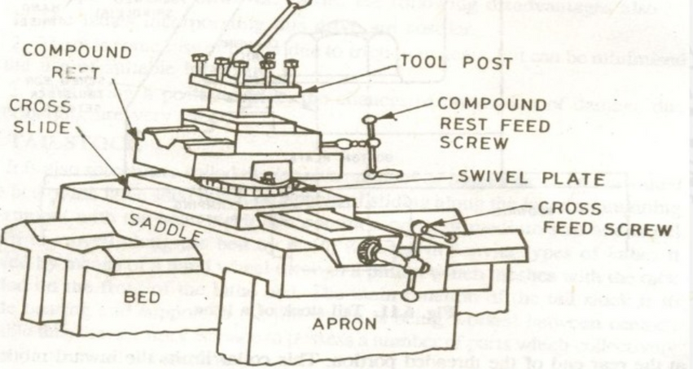
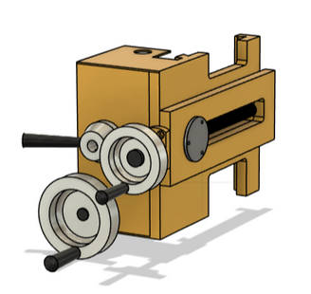
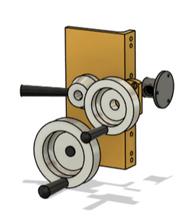
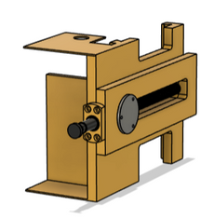

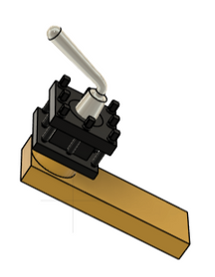
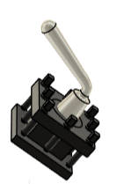
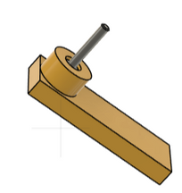

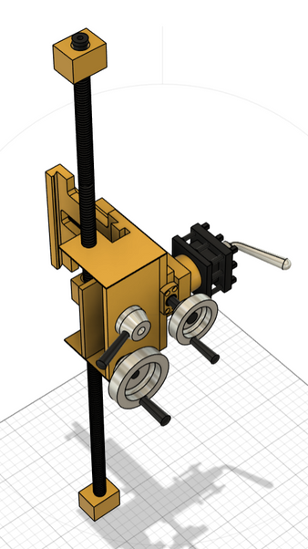
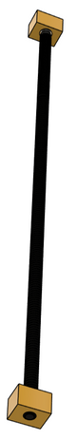
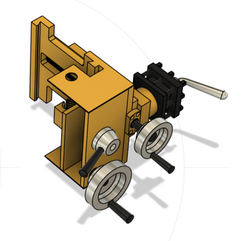
Carriage
=
+
Purpose
The carriage holds and moves the cutting tool across the lathe, allowing precise control over cutting operations on the workpiece.
=
+
Main component
Saddle: Slides along the lathe bed, providing stable support for the tool.
Cross-Slide: Moves perpendicular to the lathe bed for depth adjustment.
Compound Rest: Allows angled cuts and fine adjustments.
Tool Post: Holds the cutting tool in place.
Apron: Houses the controls for movement and holds mechanisms for automatic feed.
FUNCTIONS
Enables longitudinal and transverse tool movement.
Facilitates turning, facing, and threading operations.
=
+

Slide 8
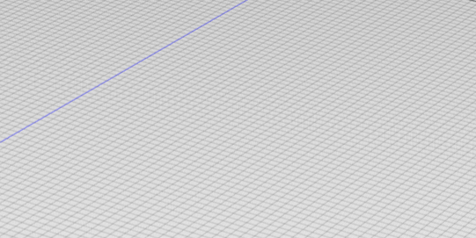
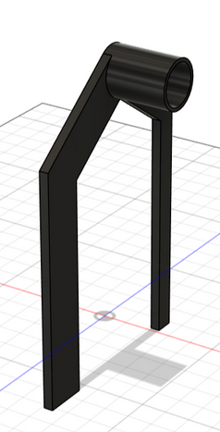
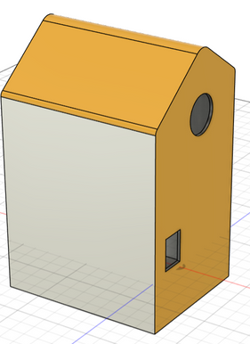
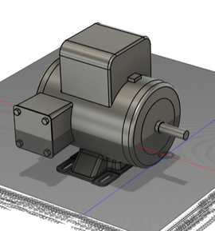
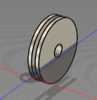




Drive
Pully
Function: The pulley in a lathe machine helps transfer power from the motor to the spindle by using belts, allowing for speed adjustments. It enables different speeds by changing belt positions, which is essential for machining different materials effectively.
Function: The pulley system offers a simple and efficient way to control spindle speed, allowing the lathe to handle a variety of tasks. It is also reliable, low-maintenance, and helps reduce motor load by efficiently transmitting power.
Motor
Function: The motor in a lathe provides the rotational power to turn the workpiece at adjustable speeds, enabling cutting, shaping, and finishing. It drives the spindle, ensuring smooth and efficient machining for precise results.
Advantage: The motor in a lathe machine enables adjustable speeds for handling various materials and cutting needs, ensuring precise, efficient machining. It provides consistent power to the spindle, allowing smooth rotation of the workpiece and reducing operator effort. This enhances productivity and accuracy in manufacturing tasks.
Chuck Support
Function: The chuck support holds and secures the workpiece in place on the spindle, allowing it to rotate accurately for machining. It provides a firm grip, ensuring stability and alignment during various cutting operations.
Advantage: Chuck support enhances precision and safety by firmly holding the workpiece, reducing vibration and preventing slippage. This stability allows for more accurate cuts, even on irregularly shaped workpieces, and improves overall machining efficiency.
+
+
+

Slide 9
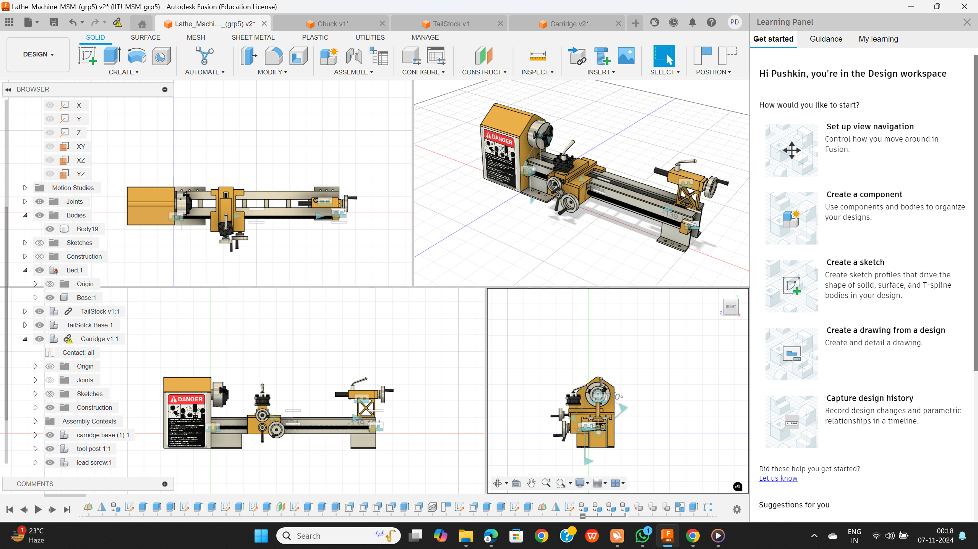

Final Assembly

Slide 10
Thank You

